Slide 1
ON-PAGE SEO

Slide 2
.
Keyword Research:
Keyword research is the process of identifying and analyzing search terms that users enter into search engines. It helps in understanding what topics are relevant to your audience, discovering new content opportunities, and optimizing your website to attract more organic traffic. Effective keyword research informs content creation, SEO strategies, and overall digital marketing efforts.
Factors to Consider for Keyword Research :
Types of Keywords 1. Short-Tail Keywords 2. Long-Tail Keywords 3. Local Keywords Tools 1. Google Keyword Planner 2. Ahrefs 3. SEMrush 4. Ubersuggest

Slide 3
.
Steps in Keyword Research: 1. Brainstorming 2. Using Tools 3. Analyzing Competitors 4. Assessing Search Intent 5. Prioritizing Keywords Keyword Metrics: 1. Search Volume 2. Keyword Difficulty 3. Click-Through Rate (CTR) 4. Cost Per Click (CPC) Incorporating Keywords: 1. On-Page Optimization 2. Content Creation 3. Internal Linking
Common Mistakes to Avoid: 1. Overemphasis on Competitors 2. Ignoring Search Intent 3. Neglecting Content Quality Best Practices: 1. Comprehensive Research 2. Focus on Value Site Auditing Report - https://drive.google.com/file/d/1U6tbXjVWSWQLqcOfpbgVokIqyWNwBpfU/view?usp=sharing

Slide 4
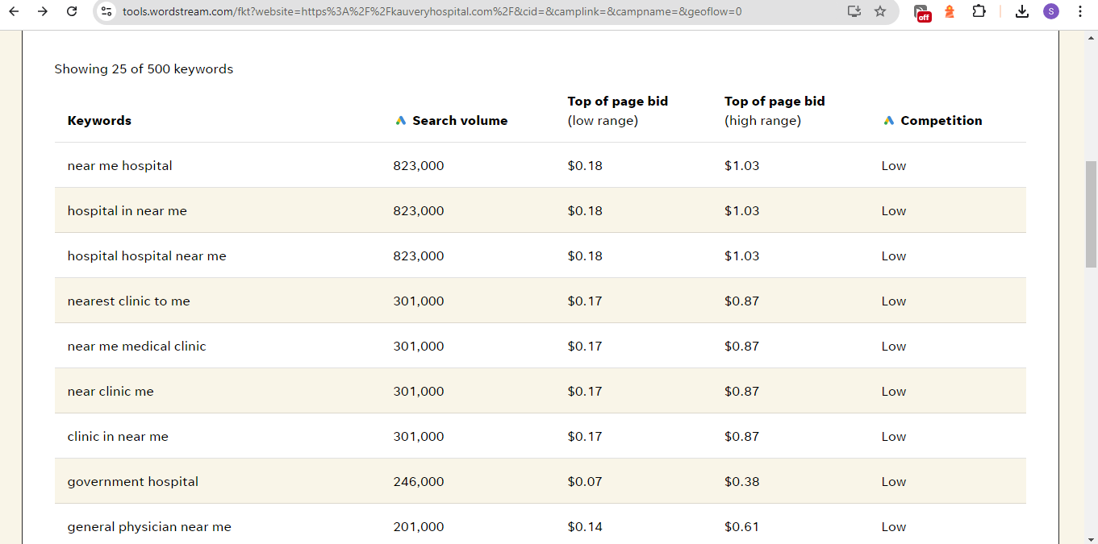

Slide 5
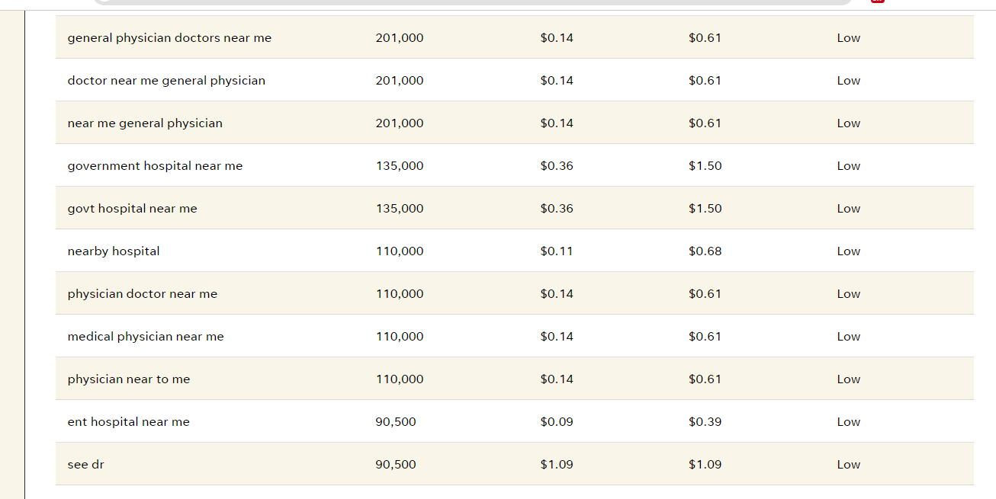

Slide 6
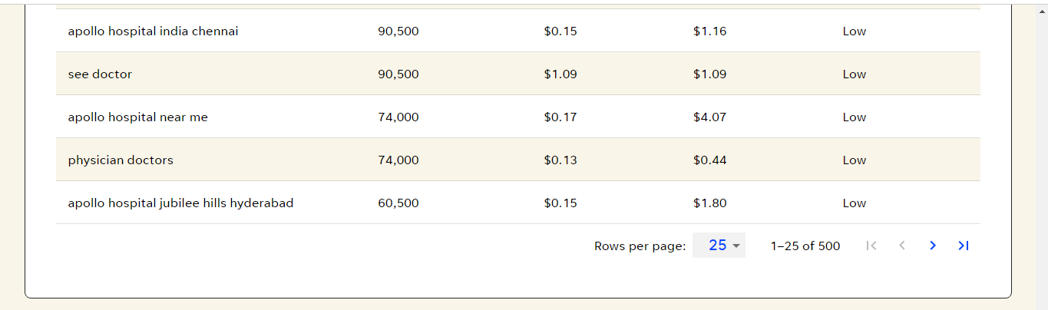

Slide 7
.
Competitor Keyword Research:
Competitor keyword research involves analyzing the keywords that your competitors are targeting and ranking for. This process helps you uncover new keyword opportunities, understand industry trends, and refine your SEO strategy. By studying competitors' keyword strategies, you can identify gaps, improve your content, and enhance your search engine rankings.
Factors to Consider for Keyword Research :
Identifying Competitors
Direct Competitors
Indirect Competitors
Local Competitors Top Performing Content Content Gaps

Slide 8
CONTENT FRESHNESS AND PLAGIARISM : Content freshness refers to the practice of regularly updating and creating new content to keep information current and relevant. Plagiarism involves using someone else’s work without proper attribution. Maintaining content freshness ensures that your site remains relevant and engaging, while avoiding plagiarism protects your site's credibility and avoids legal issues.
Factors to Consider for Keyword Research:
1. Benefits of Content Freshness 2. Strategies for Maintaining Content Freshness - Regular Updates 3. New Content Creation 4. Content Calendar 5. Monitor Trends 6. Avoiding Plagiarism - Original Content 7. Use Plagiarism Checkers
Tools and Resources: 1. Content Management Systems 2. Plagiarism Detection Tools
Common Mistakes to Avoid: 1. Ignoring Updates 2. Unacknowledged Sources 3. Copying Content

Slide 9
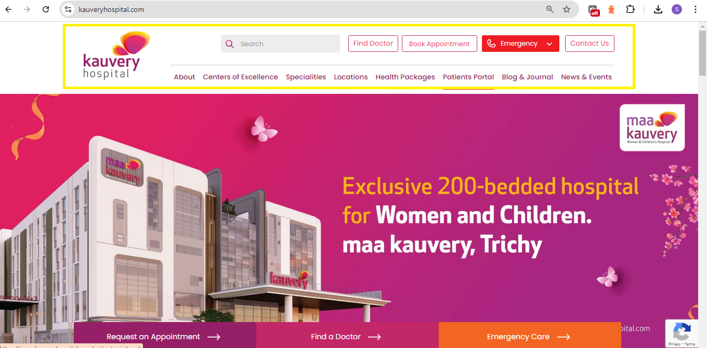
.
Navigation :
Navigation refers to the system and structure that helps users find their way around a website or application. Effective navigation enhances user experience by providing clear, intuitive paths to content and functionalities, ensuring users can easily access what they need.
Factors to Consider for Keyword Research :
1. Menus 2. Breadcrumbs 3. Search Bar 4. Buttons and Links 5. Mobile Navigation 6. Hamburger Menu 7. Sticky Navigation 8. Touch-Friendly Design 9. Keyboard Navigation 10. Screen Readers 11. Color Contrast 12. Highlight Current Page

Slide 10
.
Meta Tags and H1 to H6 Tags with Meta Tag Descriptions:
Meta tags and H1 to H6 tags are essential components for on-page SEO. Meta tags provide information about the content of a webpage to search engines, while H1 to H6 tags structure the content, making it easier for both users and search engines to understand the hierarchy and importance of different sections.
Key Factor to consider:
Meta Tags Overview:
Definition of meta tags and their role in SEO.
Importance of the "title" meta tag for search ranking.
Role of the "description" meta tag in influencing click-through rates (CTR).
Types of Meta Tags:
Title Tag: Key for search ranking, should be concise and keyword-rich.
Description Tag: Summarizes the page content, used for user engagement.
Robots Tag: Provides instructions to search engines (e.g., "noindex", "nofollow").
Viewport Tag: Optimizes the webpage for mobile devices.

Slide 11
.
H1 to H6 Tags Overview:
Importance of heading tags (H1 to H6) for content structuring.
How H1 acts as the primary headline, signaling the main topic to search engines.
The use of H2 to H6 tags for subheadings and content hierarchy.
Best Practices for Meta Tags:
Keep meta descriptions between 150-160 characters.
Use primary keywords in the title and description tags.
Avoid duplicate meta tags across pages.
Best Practices for H1 to H6 Tags:
Use one H1 tag per page to focus on the main topic.
Structure the content logically with H2-H6 tags for subtopics.
Include relevant keywords naturally in the headings.

Slide 12
.
Content Freshness and Plagiarism :
Content freshness refers to the practice of regularly updating and creating new content to keep information current and relevant. Plagiarism involves using someone else’s work without proper attribution. Maintaining content freshness ensures that your site remains relevant and engaging, while avoiding plagiarism protects your site's credibility and avoids legal issues.
Factors to Consider for Keyword Research :
1. Benefits of Content Freshness 2. Strategies for Maintaining Content Freshness - Regular Updates 3. New Content Creation 4. Content Calendar 5. Monitor Trends 6. Avoiding Plagiarism - Original Content 7. Use Plagiarism Checkers Tools and Resources 1. Content Management Systems 2. Plagiarism Detection Tools Common Mistakes to Avoid 1. Ignoring Updates 2. Unacknowledged Sources 3. Copying Content

Slide 13
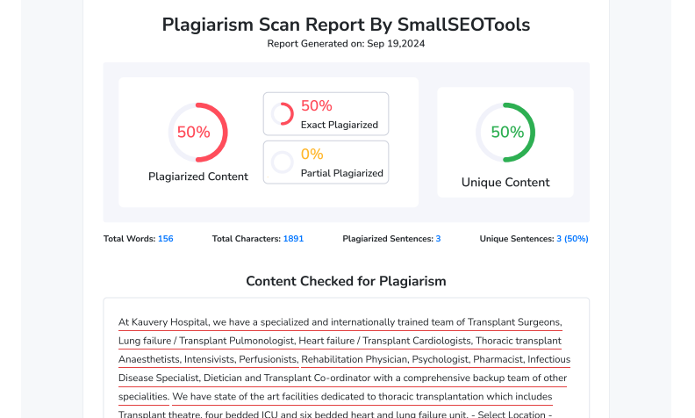
.
Plagiarism Report : https://drive.google.com/file/d/1PMn448aYTaJx3LGG_u45oTIYRR07iY1t/view?usp=sharing Tools We Used : https://smallseotools.com/plagiarism-checker/

Slide 14
.
Long-Tail and Short-Tail Keywords:
Long-tail and short-tail keywords are essential components of SEO strategies. Short-tail keywords are broad and typically consist of one or two words, while long-tail keywords are more specific phrases usually containing three or more words. Understanding and effectively utilizing both types of keywords can help improve search engine rankings, attract targeted traffic, and optimize content for various user intents.
Factors to Consider for Keyword Research :
Understanding Short-Tail Keywords: 1. High Search Volume 2. High Competition 3. Broad Intent Challenges of Short-Tail Keywords: 1. High Competition 2. Less Specific 3. Costly in Paid Search

Slide 15
.
Understanding Long-Tail Keywords: 1. Lower Search Volume 2. Lower Competition 3. Specific Inten Benefits of Long-Tail Keywords: Higher Conversion Rates Lower Competition Cost-Effective Challenges of Long-Tail Keywords: Lower Search Volume More Content Required Common Mistakes to Avoid: 1. Over-Reliance on Short-Tail Keywords 2. Neglecting Long-Tail Keywords 3. Keyword Stuffing Best Practices: 1. Keyword Research 2. Content Creation

Slide 16
.
Internal Linking Strategies:
Internal linking strategies involve creating and managing links within your own website to enhance user navigation, improve SEO, and distribute page authority. Effective internal linking helps search engines understand the structure of your site, boosts the visibility of important pages, and improves user experience by guiding visitors to relevant content.
Factors to Consider for Keyword Research :
1. Hierarchical Structure 2. Siloing 3. Optimizing Anchor Text Linking to Important Pages 1. Priority Pages 2. Page Depth Avoiding Common Mistakes 1. Broken Links 2. Overuse of Exact Match Anchor Text 3. Neglecting User Experience 1. User-Focused Linking 2. Link to Relevant Content

Slide 17
.
Site Hierarchy:
Site hierarchy refers to the organization and structure of a website's content, including how pages are arranged and linked together. A well-defined site hierarchy improves navigation, enhances user experience, and helps search engines understand the importance and relationship of each page, leading to better indexing and SEO performance.
Factors to Consider for Robots.txt:
1. Logical Structure 2. Hierarchy Levels 3. Navigation Menus 4. URL Structure 5. Consistent Layout 6. Category and Subcategory Organization 7. User Experience 8. Responsive Design 9. Regular Updates

Slide 18
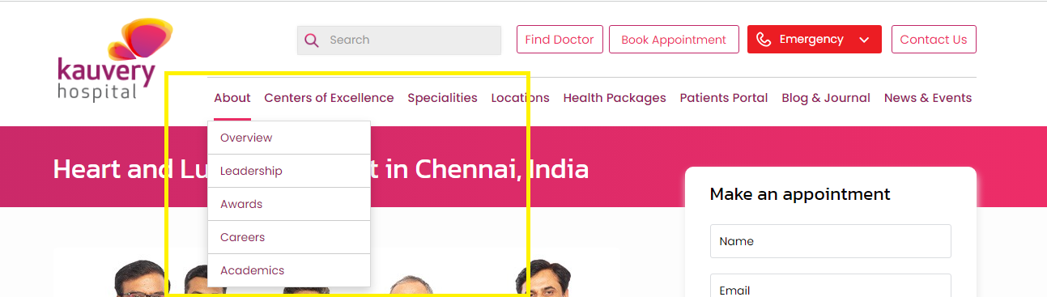
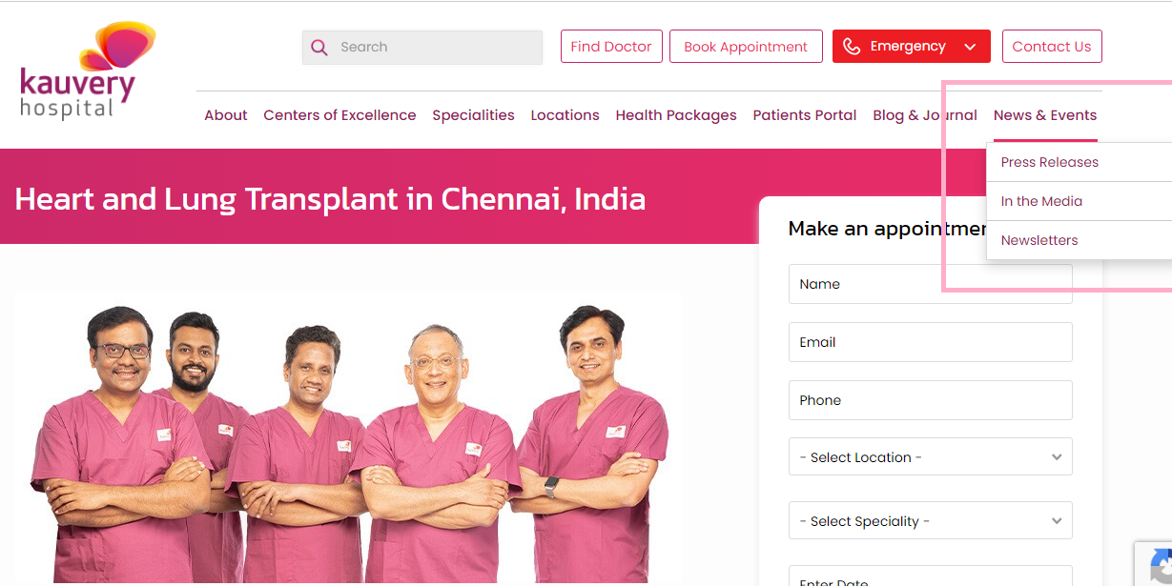
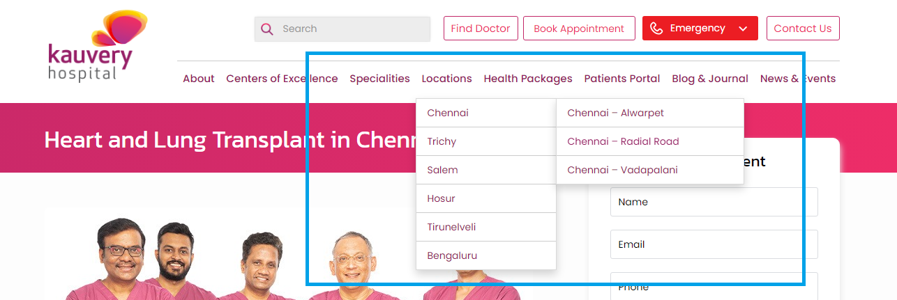

Slide 19
.
URL Structure:
URL structure refers to the organization and formatting of web addresses on a site. An effective URL structure is crucial for SEO, user experience, and site navigation. Well-structured URLs help search engines understand the content and hierarchy of a site, improve crawlability, and provide users with clear and meaningful links..
Factors to Consider for URL Structure:
1. Simplicity and Readability 2. Keywords 3. Hyphens vs. Underscores 4. Lowercase Letters 5. Avoid Special Characters 6. URL Length 7. Redirection Strategy
Reference : https://www.kauveryhospital.com/centers-of-excellence-and-specialties/heart-and-lung-transplant/

Slide 20
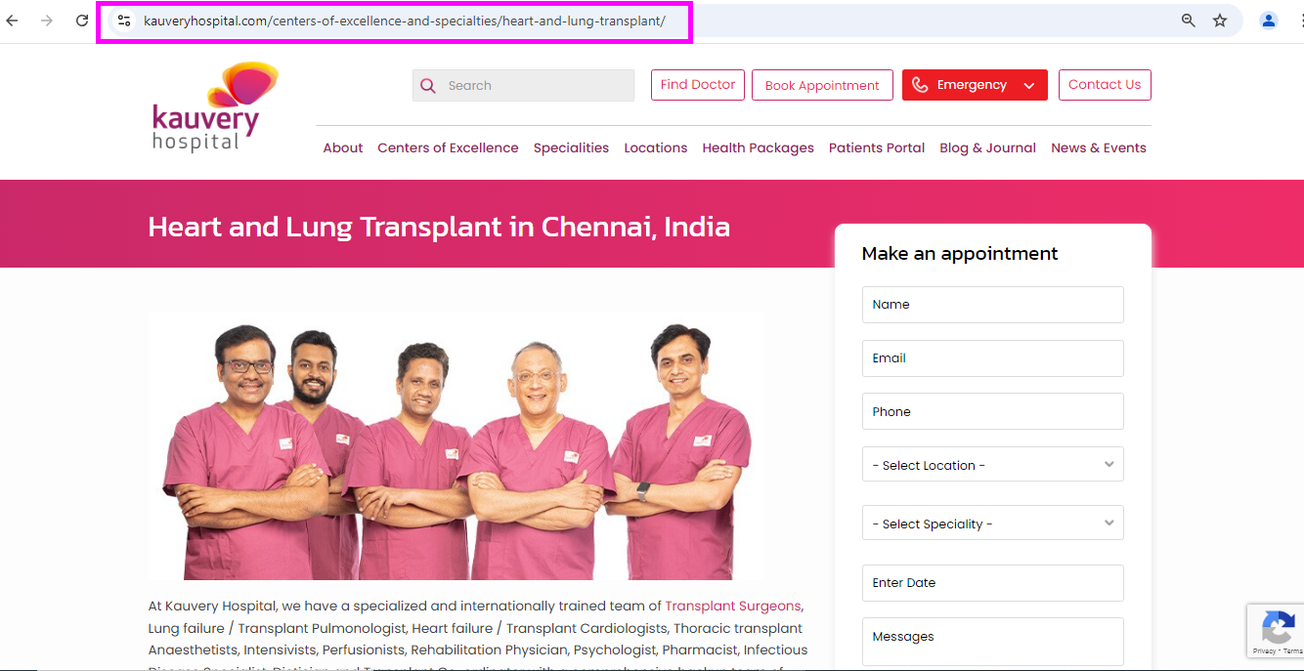
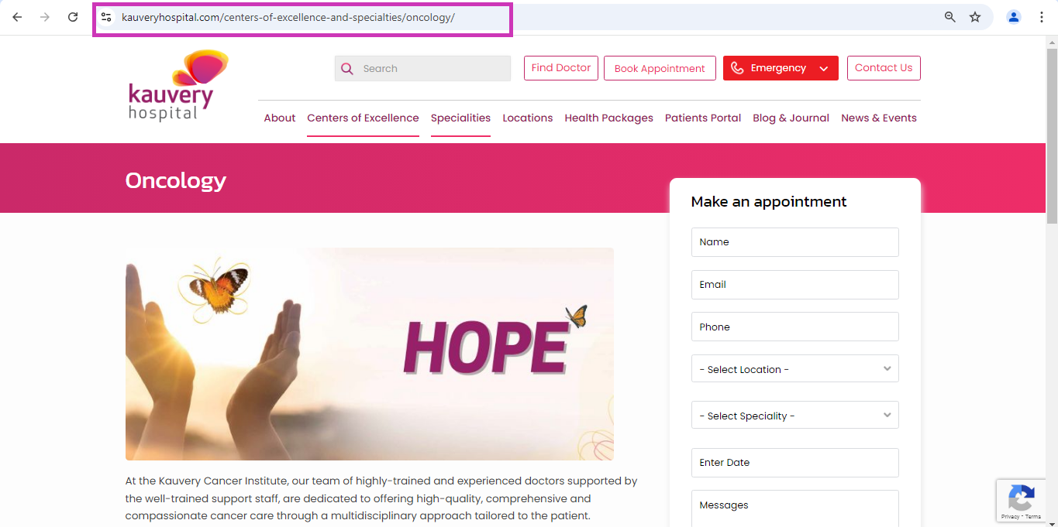

Slide 21
.
Media Metadata Optimizations :
Media metadata optimizations involve improving the data associated with media files, such as images, videos, and audio, to enhance SEO, accessibility, and user experience. Properly optimized media metadata helps search engines understand the content of media files, improves page load times, and ensures that media is accessible to all users.
Factors to Consider for Media metadata Optimizations:
1. Image Alt Text 2. Image File Names 3. Image Captions 4. Image File Size and Compression 5. Image Dimensions 6. Video Metadata 7. Video Thumbnails 8. Audio Metadata 9. Schema Markup 10. Content Delivery Network (CDN)

Slide 22
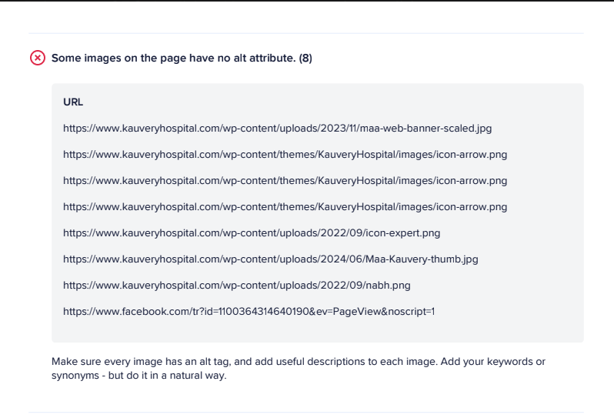

Slide 23
.
Media Descriptions Optimizations :
Media descriptions optimizations involve enhancing the textual descriptions associated with media files, such as images, videos, and audio, to improve SEO, accessibility, and user engagement. Well-optimized media descriptions help search engines understand the content, enhance user experience, and make media more discoverable.
Factors to Consider for Media Description Optimizations:
1. Image Descriptions 2. Video Descriptions 3. Audio Descriptions 4. Meta Descriptions for Media 5. Alt Text for Images

Slide 24
.
Media Comparison and Media Formats :
Media comparison and media formats involve evaluating different types of media files, such as images, videos, and audio, to determine the best formats and practices for optimizing performance, quality, and compatibility. Understanding various media formats helps in selecting the most appropriate options for web and digital use, ensuring efficient load times, and delivering high-quality content.
Factors to Consider for Media Description Optimizations:
1. Image Formats 2. Audio Formats 3. Choosing the Right Format 4. Quality vs. File Size 5. Media Optimization Strategies 6. Compression 7. Responsive Media 8. CDN Usage

Slide 25
.
Blog Writing with Landing Pages:
Blog writing involves creating informative and engaging posts, while landing pages are standalone web pages designed for conversion purposes. Combining these elements directs blog readers to specific actions through optimized landing pages.
Factors to Consider for Social Signals and Sharing Content for Backlinks :
1. Audience Research 2. High-Quality Writing 3. Compelling Headlines 4. Call-to-Action (CTA) 5. Designing Effective Landing Pages 6. Clear Messaging* 7. Form Optimization 8. Content Upgrades 9. Lead Magnets 10. Webinars and Events

Slide 26
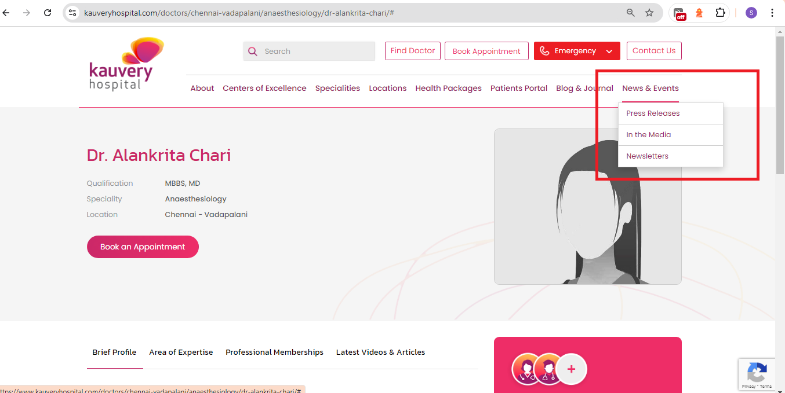

Slide 27
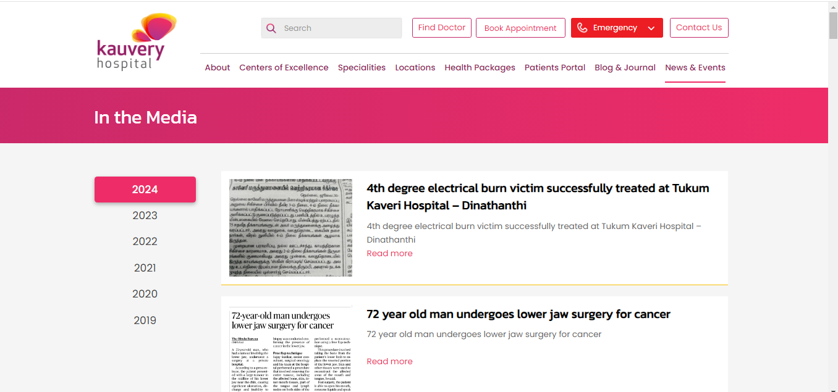
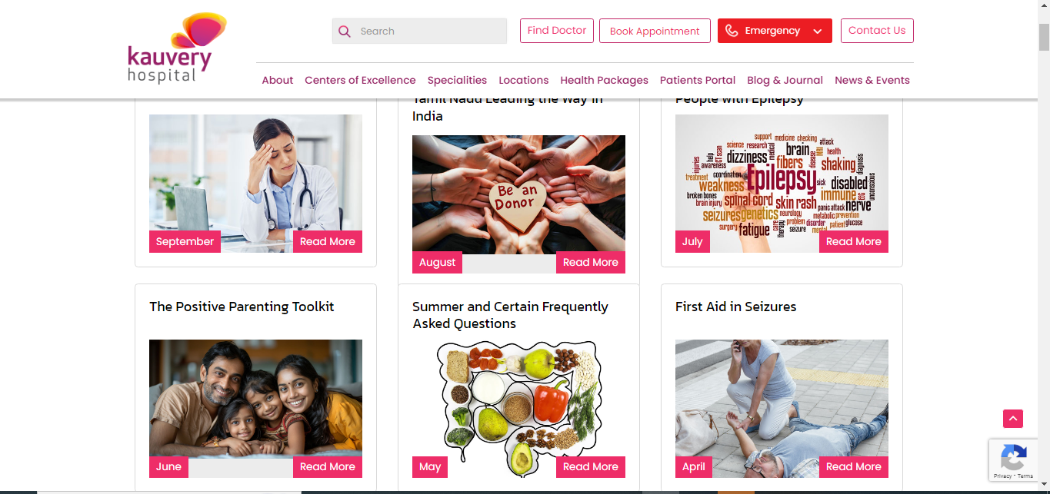

Slide 28
.
FAQ Pages:
FAQ pages are dedicated sections on a website that address common questions and concers from users. They are designed to provide clear, concise answers to frequently asked questions,improving user experience,reducing support inquery, and enhancing search engine optimization (SEO) by targeting relevant query.
FACTORS TO CONSIDER FOR FAQ PAGES:
1.Purpose and Importance(User Support,SEO Benefits)
2.Design and Structure (ClearLayout,Responsive Design)
3.Content Creation (Relevant Questions,Concise Answers, User Intent)
4.SEO Optimization (Keyword Integration,Structured Data, Internal Linking)
5.Updating and Maintenance (Regular Updates,Feedback Integration)
6.Enhanced User experience(Visual Elements,Interactive Features)
7.Accessibility and Usability (Readable Format,Accessible Design)
8.Monitoring and Analytics (Performance Tracking, User Behavior)
9.Common Mistakes to Avoid (Overloading Content,Ignoring User Input)
10.Best Pratices (Prioritize Clarity, User-Centric Approach, Regular Review)
11.Integration with Other SEO Strategies (Content Strategy, Cross-Promotion)
Reference : https://www.kauveryhospital.com/sitemap.xml
Tools : https://www.kauveryhospital.com/sitemap.xml (Own Site)
View Points : Propare Update in sitemap.xml

Slide 29
.
User Experience - Accessibility Features:
Accessibility features are tools and design elements incorporated into websites and applications to ensure they are usable by people with various disabilities. These features help to create an inclusive digital environment, accommodating users with visual, auditory, motor, and cognitive impairments.
Factors to Consider for Keyword Research :
1. Descriptions about the Particular form elements 2. Scalable Text 3. Captions and Subtitles 4. Error Messages 5. Breadcrumbs 6. Confirmation Messages

Slide 30
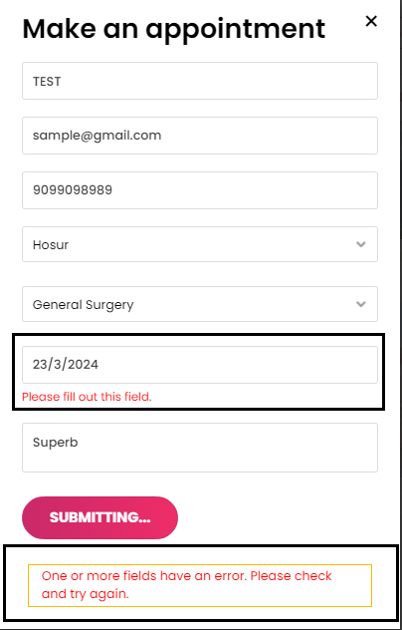
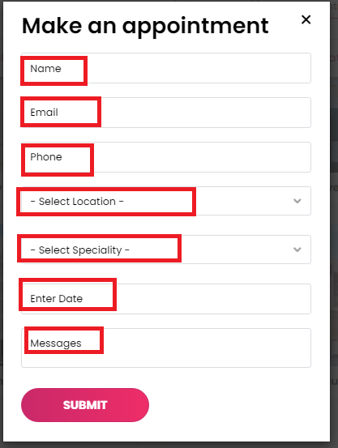

Slide 31
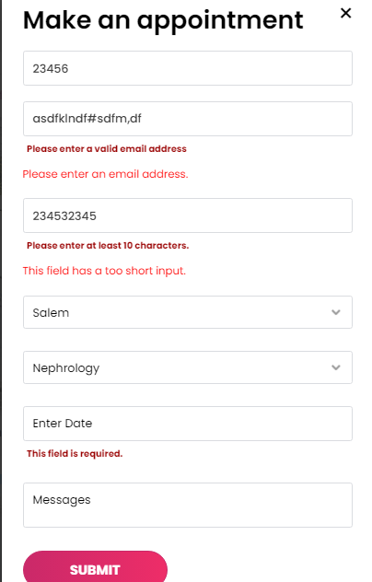

Slide 32
.
Identifying Target Keywords:
Identifying target keywords involves discovering and selecting the most relevant and effective keywords to drive traffic and achieve business goals. This process includes understanding user intent, analyzing search volume and competition, and aligning keywords with your content strategy. Effective keyword identification helps improve search engine rankings and ensures that your content reaches the right audience.
Factors to Consider for Keyword Research :
Keyword Research Tools: 1. Google Keyword Planner 2. Ahrefs, 3. SEMrush, 4. and Ubersuggest Analyzing Search Intent: 1. User Intent 2. Matching Content

Slide 33
.
Evaluating Keyword Metrics: 1. Search Volume 2. Keyword Difficulty 3. Click-Through Rate (CTR) Competitor Research Local and Niche Keywords: 1. Local Keywords 2. Niche Keywords Keyword Selection Criteria: 1. Relevance 2. Traffic Potential 3. Conversion Potential Common Mistakes to Avoid: 1. Overlooking User Intent 2. Keyword Stuffing 3. Neglecting Long-Tail Keywords

Slide 34
.
Content Quality and Relevance :
Content quality and relevance are crucial for engaging users, improving search engine rankings, and achieving business goals. High-quality content is well-written, informative, and valuable to the target audience, while relevance ensures that content meets the needs and interests of users and aligns with their search intent. Focusing on these factors helps drive traffic, enhance user experience, and build trust with your audience.
Factors to Consider for Keyword Research :
1. Understanding Content Quality 2. Key Aspects of High-Quality Content 3. Understanding Content Relevance 4. Aligning with User Intent 5. Creating Valuable Content 6. Content Structure and Formatting 7. Measuring Content Effectiveness

Slide 35
OFF-PAGE SEO

Slide 36
.
User-Generated Content:
User-generated content (UGC) refers to any content created by users or customers rather than the brand itself. This can include reviews, comments, photos, videos, and social media posts. UGC helps build community, foster engagement, and enhance authenticity, as it reflects real user experiences and opinions.
Factors to Consider for Keyword Research :
Types of User-Generated Content: 1. Reviews and Testimonials 2. Social Media Posts 3. Photos and Videos 4. Blog Comments 5. Forums and Discussions Encouraging User-Generated Content: 1. Contests and Challenges 2. Hashtag Campaigns 3. Customer Reviews 4. Social Media Engagement

Slide 37
.
Tools and Resources: 1. UGC Platforms: 1. [Yotpo](https://www.yotpo.com/), 2. [Bazaarvoice](https://www.bazaarvoice.com/), 3. and [Stackla](https://stackla.com/) Social Media Monitoring: 1. [Hootsuite](https://hootsuite.com/), 2. [Sprout Social](https://sproutsocial.com/), 3. [Mention](https://mention.com/) Content Moderation Tools: 1. [Moderation Gateway](https://moderationgateway.com/), 2. [Content Moderation](https://www.content-moderation.com/), 3. [NetModerator](https://www.netmoderator.com/)

Slide 38
.
Backlink Strategies:
Backlink strategies involve techniques for acquiring and managing backlinks to improve your website’s search engine rankings and authority. Effective backlink strategies help enhance your site’s credibility, drive traffic, and boost SEO performance by obtaining high-quality links from reputable sources.
Factors to Consider for Keyword Research :
Types of Backlinks: 1. Editorial Backlinks 2. Guest Post Backlinks 3. Directory Backlinks 4. Social Media Backlinks 5. Forum and Blog Comments Link Building Techniques: 1. Content Marketing 2. Guest Blogging 3. Broken Link Building 4. Influencer Outreach 5. Competitor Analysis

Slide 39
.
Quality Over Quantity: 1. High-Authority Sites 2. Relevance 3. Anchor Text Avoiding Bad Practices: 1. Avoiding Spammy Links 2. Avoiding Link Farms 3. Natural Link Building Link Building for Local SEO: 6. Local Directories 7. Local Partnerships 8. Local Content Content-Driven Link Building: 1. Resource Pages 2. Case Studies 3. Research and Surveys
Link Building Best Practices: 1. Build Relationships 2. Provide Value Measuring Backlink Success: 1. Traffic and Rankings 2. Domain Authority 3. Referral Traffic Backlink Analysis Tools: 1. Ahrefs, 2. SEMrush, 3. Moz, 4. Google Search Console

Slide 40
.
Report Backlinks - https://drive.google.com/file/d/1xFby-M_sos_Q1ozucPGOf05WpR8TrUwe/view?usp=sharing Backlinking Auditing Report - https://drive.google.com/file/d/1IMRnORDYA5uTXhE7-yYLpNJeKdNy-CKH/view?usp=sharing Tools 1. https://backlinko.com/tools/backlink-checker 2. https://www.semrush.com/analytics/backlinks/?irclickid=SI8xr-yB%3AxyKT5mQqa2MazcEUkCyUB0hqQkAWI0&utm_source=affiliate&utm_Medium=impact&utm_campaign=393581&utm_terms=&utm_content=&irgwc=1&utm_medium=impact&utm_term=

Slide 41
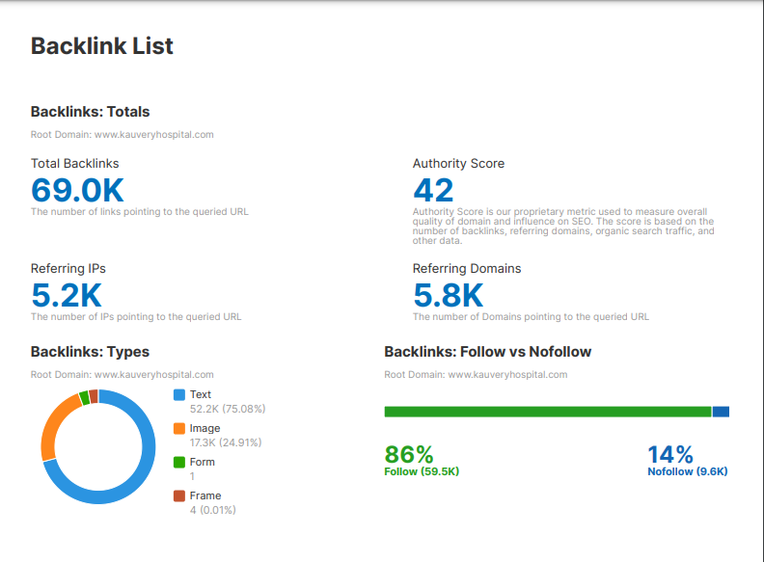

Slide 42
.
Social Signals and Sharing Content for Backlinks:
Social signals and sharing content for backlinks involve leveraging social media engagement and content distribution to boost your website’s authority and attract backlinks. By increasing your content’s visibility and encouraging social interaction, you enhance its chances of earning high-quality backlinks and improving search engine rankings.
Factors to Consider for Social Signals and Sharing Content for Backlinks :
1. Content Promotion Share your content across various social media platforms, including Facebook, Twitter, LinkedIn, Instagram, and Pinterest, to reach a broader audience. 2. Influencer Collaboration 3. Creating Shareable Content 4. Social Sharing Buttons 5. Open Graph Tags 6. Twitter Cards 7. Outreach Campaigns 8. Guest Posting 9. Paid Promotion 10. Search Engine Ads 11. Native Advertising 12. Identify Influencers 13. Partnerships

Slide 43
.
Google My Business Optimizations:
Google My Business (GMB) optimization involves enhancing your GMB profile to improve local search visibility, attract more customers, and provide essential business information. Effective GMB optimization helps your business appear prominently in local search results and Google Maps.
Factors to Consider for Keyword Research :
1. Identifying Local Keywords 2. Claiming and Verifying Your Business 3. Business Name 4. Address 5. Phone Number 6. Website URL 7. Primary Category

Slide 44
.
8. Additional Categories 9. Business Hours - Accurate Hours 10. Business Hours - Regular Updates 11. Writing a Compelling Business Description - Keyword Integration 12. Writing a Compelling Business Description - Clear and Concise 13. High-Quality Images 14. Video Content 15. Collecting and Managing Reviews - Encourage Reviews 16. Collecting and Managing Reviews - Respond to Reviews 17. Collecting and Managing Reviews - Monitor Feedback 18. Using Google Posts - Regular Updates 19. Using Google Posts - Visual Appeal 20. Utilizing Questions and Answers - Monitor Questions 21. Utilizing Questions and Answers - Provide Answers 22. Business Attributes 23. Feature Highlights 24. Local Keywords 25. Local Listings

Slide 45
.
Outreach Techniques:
Outreach techniques involve strategies to connect with individuals or organizations to build relationships, earn backlinks, and promote content. Effective outreach helps increase visibility, drive traffic, and enhance your site's authority through collaborations and link-building efforts
Factors to Consider for Keyword Research :
1. Influencers 2. Bloggers 3. Journalists 4. Industry Experts
5. Crafting Effective Outreach Emails 6. Creating Valuable Content for Outreach 7. Building Relationships - Engage on Social Media 8. Attend Events 9. Provide Value 10. Outreach Tools - Utilize outreach tools like BuzzStream, Pitchbox, or Hunter to streamline and manage outreach campaigns. 11. Guest Posting 12. Joint Ventures 13. Cross-Promotions. 14. Broken Link Building 15. Content Repurposing

Slide 46
TECHNICAL SEO

Slide 47
Crawlability:
Crawlability refers to a website's ability to be easily found, accessed, and indexed by search engine bots. If a site is crawlable, it means search engines can efficiently discover and understand its content, leading to better rankings and visibility. Ensuring good crawlability is key to effective SEO.
Factors to Consider for Crawlability:
1. Website Structure 2. Sitemap 3. Robots.txt File 4. Internal Linking 5. URL Structure 6. Page Load Speed 7. Mobile Friendliness 8. Redirects 9. Duplicate Content 10. Broken Links 11. Meta Tags
Tools used for Crawlability: Google Search Console

Slide 48
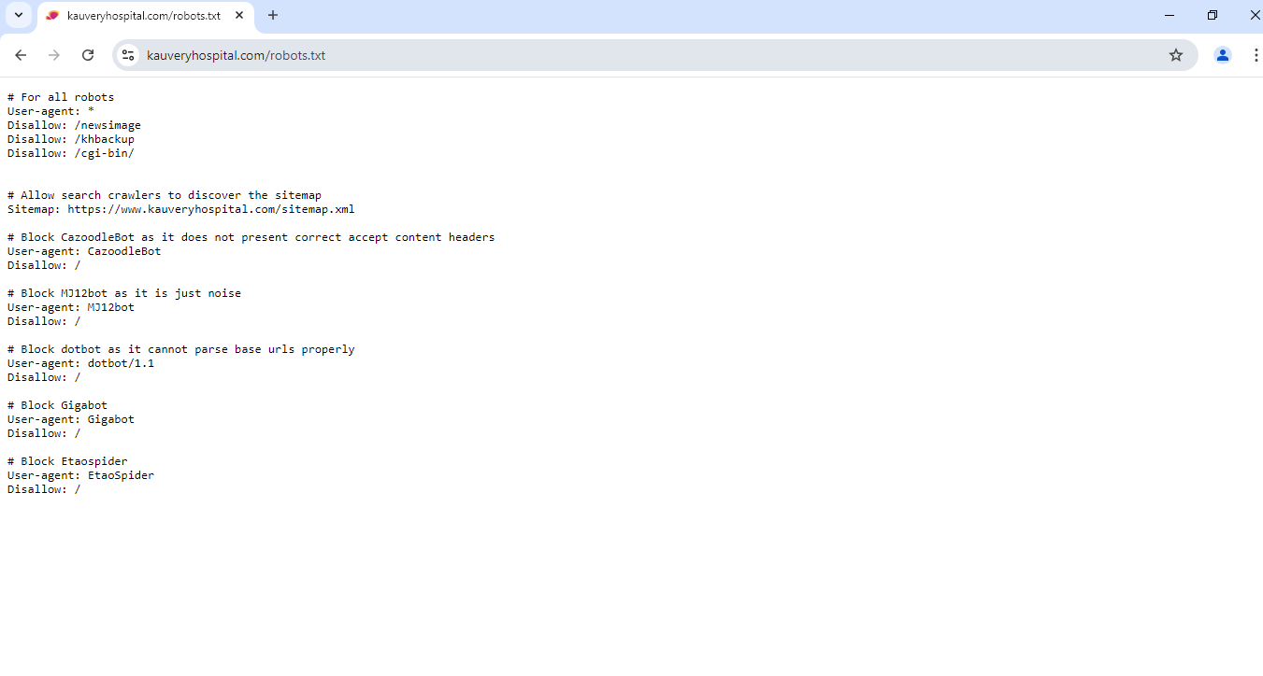
.
Robots.txt:
The `robots.txt` file is a simple text file placed in a website's root directory to guide search engine crawlers on which pages or sections of the site should or shouldn't be crawled. It's a crucial tool for managing a website's crawl budget, protecting sensitive information, and optimizing search engine indexing.
Factors to Consider for Robots.txt:
1. File Placement 2. Syntax 3. Disallow Sensitive Pages 4. Allow Important Pages 5. Avoid Blocking CSS/JS Files 6. Testing and Validation 7. Case Sensitivity 8. Updates and Monitoring
Reference : https://www.kauveryhospital.com/robots.txt
Tools : https://www.kauveryhospital.com/robots.txt
View Points : Catalog based Robots.txt Propare Update in Robots.txt file

Slide 49
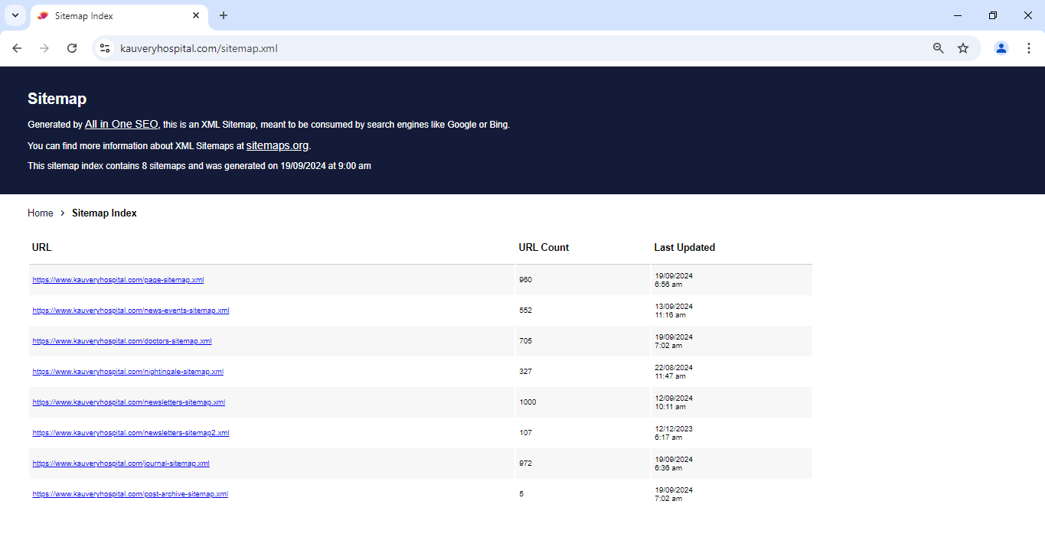
.
XML Sitemap:
An XML sitemap is a file that lists all the important pages of a website, providing search engines with a roadmap to discover and index content more efficiently. It helps ensure that search engines can find all the critical pages, especially those that are newly added or not easily accessible through internal linking.
Reference : https://www.kauveryhospital.com/sitemap.xml
Tools : https://www.kauveryhospital.com/sitemap.xml (Own Site)
View Points : Propare Update in sitemap.xml

Slide 50
.
Duplicate Content /copied content:
Duplicate content refers to substantial blocks of identical or very similar content that appear across multiple pages of a website or on different websites. This can cause search engines to struggle with deciding which version to index and rank, potentially leading to lower visibility in search results. Managing duplicate content is crucial for improving SEO and ensuring a consistent user experience.
Factors to Consider for Duplicate Content:
Fake contents that are copied from the other websites.
Tools : https://smallseotools.com/plagiarism-checker/ Plagarism Report : https://drive.google.com/file/d/1PMn448aYTaJx3LGG_u45oTIYRR07iY1t/view?usp=sharing

Slide 51
.
URL Structure:
URL structure refers to the organization and formatting of web addresses on a site. An effective URL structure is crucial for SEO, user experience, and site navigation. Well-structured URLs help search engines understand the content and hierarchy of a site, improve crawlability, and provide users with clear and meaningful links..
Factors to Consider for URL Structure:
1. Simplicity and Readability 2. Keywords 3. Hyphens vs. Underscores 4. Lowercase Letters 5. Avoid Special Characters 6. URL Length 7. Redirection Strategy
Reference : https://www.kauveryhospital.com/centers-of-excellence-and-specialties/heart-and-lung-transplant/

Slide 52
.
Internal Linking and External Linking:
Internal linking refers to the practice of linking to other pages within the same website. Proper internal linking enhances site navigation, helps distribute page authority, and improves the overall user experience. It also aids search engines in crawling and indexing your site more effectively.
Factors to Consider for Duplicate Content:
1. Anchor Text 2. Page Authority Distribution 3. Contextual Linking 4. Avoid Over-Linking 5. Siloing and Thematic Grouping 6. Link Depth 7. Broken Links 8. Use of Navigation Menus 9. Content Updates 10. Track and Analyze 11. Breadcrumbs 12. Link Equity
Tools Used : https://www.deadlinkchecker.com/
Report Source : https://drive.google.com/file/d/1p_0nAfnln2oUAwH_gu9UCeLxUP0tL1F0/view?usp=sharing

Slide 53
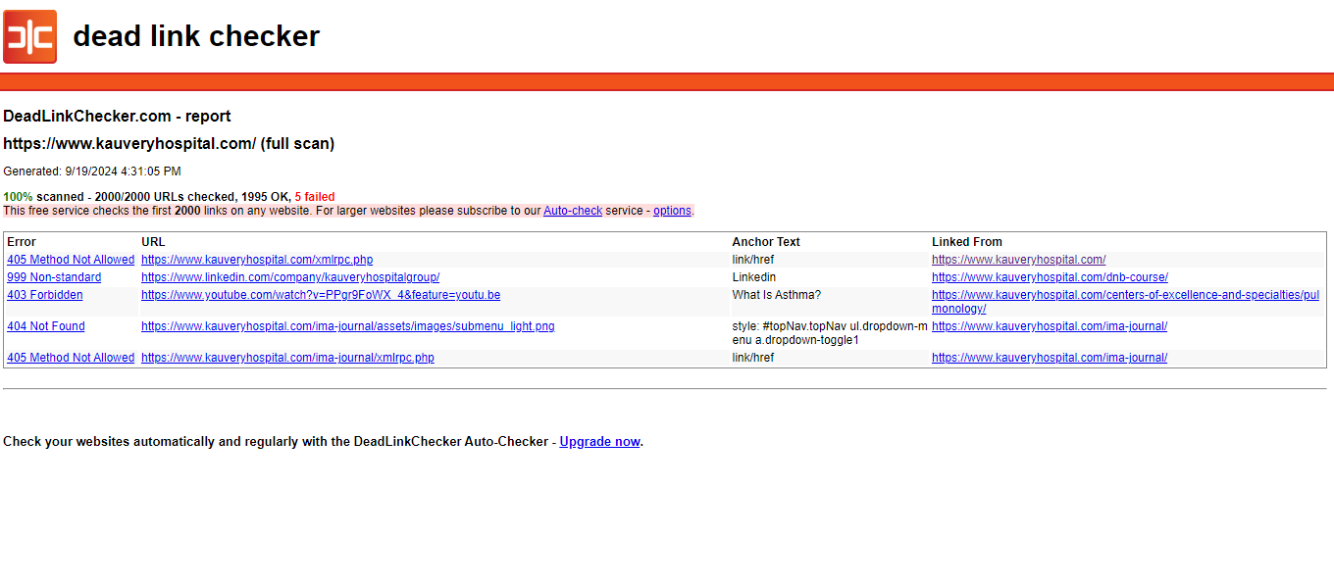
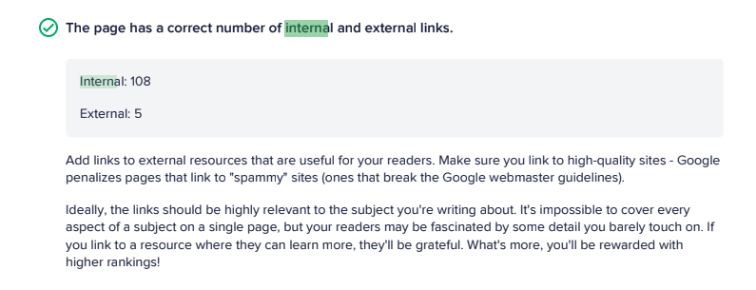

Slide 54
.
Site Speed:
Site speed refers to how quickly web pages load and become interactive for users. A fast-loading website improves user experience, reduces bounce rates, and positively impacts search engine rankings. Site speed is a critical factor in both SEO and overall site performance, influencing how visitors engage with your content.
Factors to Consider for Backlinks:
1. Page Load Time 2. Optimizing Images 3. Minimizing HTTP Requests 4. Leveraging Browser Caching 5. Content Delivery Network (CDN) 6. Minifying Code 7. Asynchronous Loading 8. Reducing Server Response Time 9. Optimizing Web Fonts 10. Implementing Lazy Loading 11. Reducing Redirects* 12. Mobile Optimization 13. Regular Performance Audits 14. Testing and Benchmarking

Slide 55
.
Report : :
Google Light House -> https://pagespeed.web.dev/analysis/https-www-kauveryhospital-com/6zud8qddu2?form_factor=desktop&category=performance&category=accessibility&category=best-practices&category=seo&hl=en-US&utm_source=lh-chrome-ext Speed Test Perfomance - Mobile - Report - https://drive.google.com/file/d/1z36v_n5bod53uzaWO4vmyTGRq5vxYyN7/view?usp=sharing Speed Test Performance - Desktop - report - https://drive.google.com/file/d/1ZHKL-YH6GDWMCLhWXPyTGoO5O_9j4_yc/view?usp=sharing
Tools :
Google Light Houes - https://chromewebstore.google.com/detail/lighthouse/blipmdconlkpinefehnmjammfjpmpbjk?hl=en

Slide 56
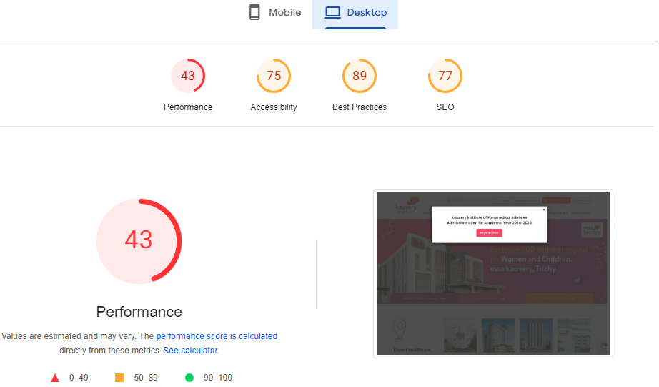

Slide 57
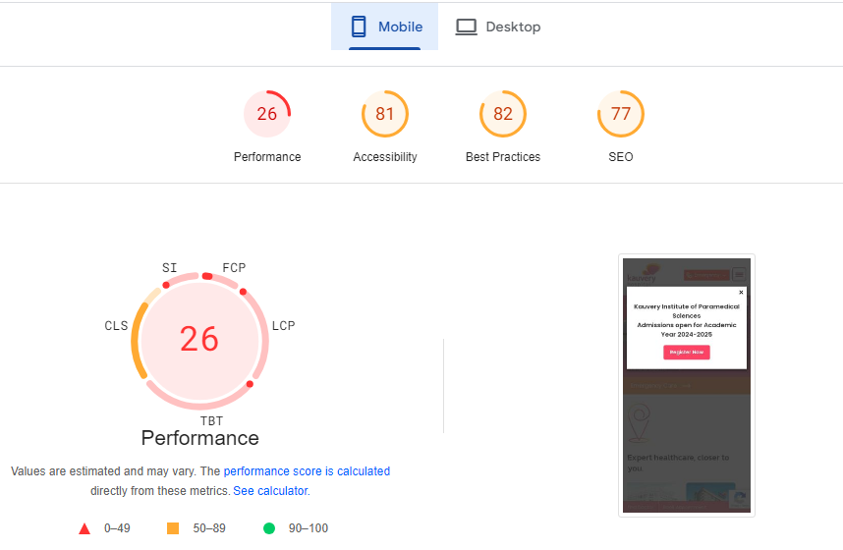

Slide 58
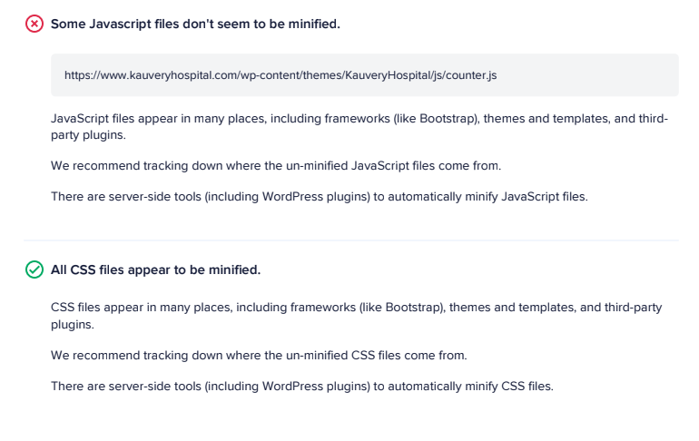
.
Code Minifications :
Code minification is the process of reducing the size of code files by removing unnecessary characters, such as white spaces, comments, and redundant code. This helps improve site performance by decreasing file size, which leads to faster loading times and better user experience. Minified code is crucial for optimizing website speed and efficiency.
Factors to Consider for Duplicate Content:
Types of Code 2. Tools and Plugins 3. Automated Minification 4. Source Maps 5. Compression 6. Version Control 7. Performance Impact 8. Security Considerations
Site Auditing Report :
Google Light House -> https://pagespeed.web.dev/analysis/https-www-kauveryhospital-com/6zud8qddu2?form_factor=desktop&category=performance&category=accessibility&category=best-practices&category=seo&hl=en-US&utm_source=lh-chrome-ext

Slide 59
.
404 Errors:
404 errors occur when a user attempts to access a webpage that cannot be found on the server. These errors indicate broken or missing links and can negatively impact user experience and SEO. Addressing 404 errors effectively helps maintain site integrity, improve user satisfaction, and preserve search engine rankings.
Factors to Consider for 404 Errors:
1. Identification of 404 Errors 2. Custom 404 Page 3. Redirects 4. Fix Broken Links
Site Auditing Report -> No 404 Error Page

Slide 60
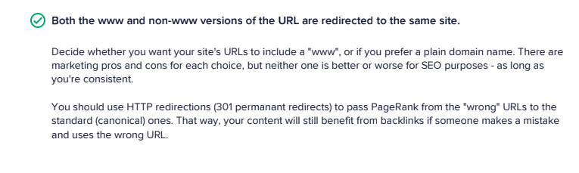
.
Redirections 301,302:
Redirects are used to send users and search engines from one URL to another. The two most common types are 301 and 302 redirects. A 301 redirect indicates a permanent change, while a 302 redirect signifies a temporary change. Understanding and properly implementing these redirects is crucial for maintaining SEO value, improving user experience, and managing site changes effectively.
Factors to Consider for Redirections 301,302:
1. 301 Redirects (Permanent Redirects) 2. 302 Redirects (Temporary Redirects)
Site Auditing Report -> Redirection Pages are available

Slide 61
.
STRUCTURED DATA FOR VOICE SEARCH:
Structured data for voice search involves using specific markup to help search engines understand and present your content in response to voice queries. By implementing structured data, you can enhance the visibility of your content in voice search results, improve accuracy, and ensure that your information is delivered effectively to users who use voice assistants.
Factors to Consider for Structured data for Voice Search:
1. Understanding Structured data 2. Importance of Structured Data for Voice Search( Voice Search Optimization, Improved Accuracy) 3. Types of Structured Data Markup (Schema.org, JSON-LD, Microdata , RDFa) 4. Key schema Types for Voice Search 5. Implementation Best Practice (Validate Markup Monitor Performance) 6. Optimizing for Conversational Queries (Direct Answer, Natural Language Concise Information) 7. Enhancing User Experience (Rich Snippet Featured Snippets) 8. Voice Search Trends and Data(Voice search Growth ,User Behaviour)
9.Common Mistakes to Avoid(Incomplete Mark up ,Ignoring Updates)
10. Future Considerations(Evolving standards ,SEO Strategies)

Slide 62
.
Search Engine Updates and Guidelines :
Search engine updates and guidelines refer to the changes and best practices implemented by search engines, such as Google, to improve the relevance and quality of search results. Staying informed about these updates and adhering to the guidelines is crucial for optimizing website performance and maintaining search engine rankings.
Factors to Consider for Keyword Research :
Major Search Engine Updates: 1. Google Core Updates 2. Google Page Experience Update 3. Google BERT Update 4. Google E-A-T (Expertise, Authoritativeness, Trustworthiness) Staying Informed About Updates: 1. Official Blogs and Announcements 2. Industry News

Slide 63
.
Adhering to Search Engine Guidelines: 1. Google Webmaster Guidelines 2. Content Quality 3. Technical SEO Key Areas of Focus for Compliance: 1. On-Page SEO 2. Mobile Optimization 3. Page Speed 4. Secure Website (HTTPS) Impact of Updates on SEO Strategies: 1. algorithm Adjustments 2. Penalty Recovery 3. Continuous Improvement Tools and Resources: 1. Google Search Console**: [Google Search Console](https://search.google.com/search-console/about) 2. Google Analytics**: [Google Analytics](https://analytics.google.com/) 3. SEO Tools**: 1. [Moz](https://moz.com/) 2. [SEMrush](https://www.semrush.com/) 3. [Ahrefs](https://ahrefs.com/) 4. Industry Blogs**: [Search Engine Journal](https://www.searchenginejournal.com/), [Search Engine Land](https://searchengineland.com/), 5. [Neil Patel](https://neilpatel.com/)

Slide 64
.
SEO Ethical Best Practices: 1. Focus on User Experience 2. Create High-Quality Content 3. Optimize for Relevant Keywords 4. Follow Search Engine Guidelines 5. Use Proper On-Page SEO 6. Ensure Mobile-Friendliness 7. Secure Your Website (HTTPS) 8. Build Genuine Backlinks 9. Avoid Black-Hat Techniques 10. Maintain Transparency 11. Engage in Ethical Link Building 12. Provide Accurate Information 13. Practice Ethical Data Collection 14. Encourage Genuine User Reviews 15. Be Ethical in Local SEO

